Slide 1
Analytic Functions

Slide 2

Objectives
After completing this lesson, you should be able to generate reports using analytic functions.

Slide 3
Review Aggregation Functions
Aggregation Function:
  Sum()
  Max()
  Count()
  …
Example:
Select deptid,sum(sal) “total_sal_dept” from emp group by deptid;
DEPTID TOTAL_SAL_DEPT
---------- -------------------------
10 4400
20 19000
30 24900
…
Using aggregation function,return only one line for each group.

Slide 4


What’s Analytic Function
Analytic function :
Analytic function is used to calculate some aggregate values based on group, the difference between it and the aggregation function is: return to multiple lines for each group, and the aggregation function returns only one line for each group.
How to list each people in their department according to the
salaries of high and low order number?
LAST_NAME DEPARTMENT_ID SALARY sort_number
--------------- ------------------ -------------- ----------------
Whalen 10 4400 1
Hartstein 20 13000 1
Fay 20 6000 2
…

Slide 5
General Analytic Function
row_number() over(partition by... order by...)
rank() over(partition by... order by...)
dense_rank() over(partition by... order by...)
count() over(partition by... order by...)
max() over(partition by... order by...)
min() over(partition by... order by...)
sum() over(partition by... order by...)
avg() over(partition by... order by...)
first_value() over(partition by... order by...)
last_value() over(partition by... order by...)
lag() over(partition by... order by...)
lead() over(partition by... order by...)
…

Slide 6
Partition by and Order by and Windowing Cause
Patition by：Is used to partition
Function_name(…) Over( partition by col_name )
Order by：Is used to sort by set column
Function_name(…) Over( order by col_name [windowing])
Windowing：Is used to define a variable or fixed data window method
rows|range between (n|unbounded preceding)|(current row) and (n|unbounded following)|(current row))
rows: Row window,A physical offset
range: Range window,A logical offset
unbounded: Without limiting the offset size

Slide 7
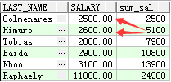
Sum(…) over(…)
Sum() over()：Computes the cumulative sample running sum
select last_name,salary,sum(salary) over(order by salary) as "sum_sal" from employees
WHERE department_id=30;

Slide 8
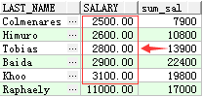
Sum(…) over(…)
Sum() over()： Computes the cumulative sample running sum
select last_name,salary,sum(salary) over(order by salary rows between 2 preceding and 2 following) as "sum_sal"
from employees
WHERE department_id=30;

Slide 9

Sum(…) over(…)
Sum() over()：Computes the cumulative sample running sum
select last_name,salary,sum(salary) over(order by salary range between
200 preceding and 200 following) as "sum_sal"
from employees
WHERE department_id=30;

Slide 10

Sum(…) over(…)
Sum() over()：Computes the cumulative sample running sum
select last_name,salary,sum(salary) over(order by salary range between
unbounded preceding and unbounded following) as "sum_sal"
from employees
WHERE department_id=30;
In this example,when using “unbounded” in between cause,using “range” as same as using “rows”.

Slide 11
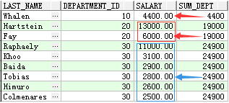
Sum(…) over(…)
Sum() over()：Computes the cumulative sample running sum
select last_name,department_id,salary,sum(salary) over (partition by
department_id) sum_dept
from employees
where department_id in(10,20,30);

Slide 12
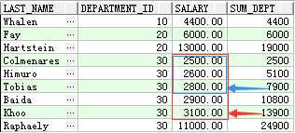
Sum(…) over(…)
Sum() over()：Computes the cumulative sample running sum
select last_name,department_id,salary,sum(salary) over (partition by department_id order by salary) sum_dept
From employees
where department_id in(10,20,30);

Slide 13
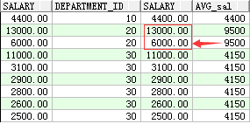
Avg(…) over(…)
Aum() over()：Returns a running average
select salary,department_id,salary,avg(salary) over(partition by
department_id) "AVG_sal"
from employees
where department_id in(10,20,30);

Slide 14
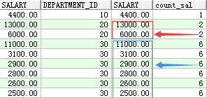
Count(…) over(…)
Count() over()：Returns a running count of all records or by partition
select salary,department_id,salary,count(salary) over(partition by
department_id) "count_sal"
from employees
where department_id in(10,20,30);

Slide 15
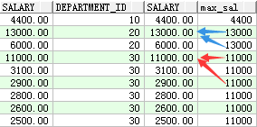
Max(…) over(…)
Max () over()：Returns the maximum value by partition
select salary,department_id,salary,max(salary) over(partition by
department_id) “max_sal"
from employees
where department_id in(10,20,30);

Slide 16
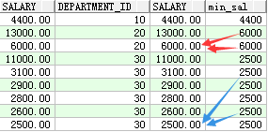
Min(…) over(…)
Min () over()：Returns the minimum value by partition
select salary,department_id,salary,min(salary) over(partition by
department_id) “min_sal"
from employees
where department_id in(10,20,30);

Slide 17
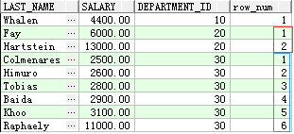
Row_number(…) over(…)
Row_number () over()：
Assigns a unique number to each row to which it is applied (either each row in the partition or each row returned by the query), in the ordered sequence of rows specified in the order by clause, beginning with 1.
select last_name,salary,department_id,row_number() over(partition by department_id order by salary) as "row_num"
from employees
where department_id in(10,20,30) order by department_id ;

Slide 18
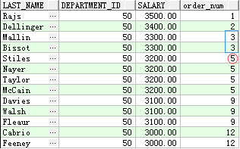
Rank(…) over(…)
Rank () over()： Calculates the rank of a value in a group of values
select last_name,salary,department_id,rank() over(partition by department_id order by salary desc) as "row_num"
from employees
where department_id =50 and (salary between 3000 and 3500) ;
Using rank function, sequence of discontinuity occurs when there is the same sequence.

Slide 19
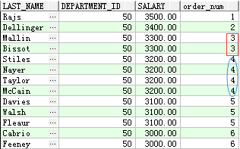
Dense_rank(…) over(…)
Dense_rank () over()： Ranks items in a group leaving no gaps in ranking sequence when there are ties
select last_name,salary,department_id,dense_rank() over(partition by department_id order by salary desc) as "row_num"
from employees
where department_id =50 and (salary between 3000 and 3500) ;
Using dense_rank function, sequence of continuous occurs when there is the same sequence.

Slide 20
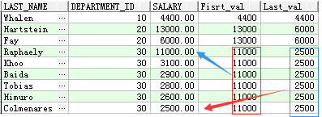
First_value() and Last_value()
First_value() over()： Returns the first value in an ordered set of values. If the first value in the set is null, then the function returns null unless you specify IGNORE NULLS
Last_value() over() Returns the last value in an ordered set of values. If the last value in the set is null, then the function returns null unless you specify IGNORE NULLS.
select last_name,department_id,salary,
first_value(salary) over(partition by department_id ) as “Fisrt_val",
last_value(salary) over(partition by department_id ) as “Last_val"
from employees
where department_id in(10,20,30);

Slide 21
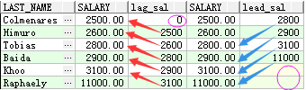
Lag(…) and Lead(…)
lag(column,n,default)
provides access to more than one row of a table at the same time without a self-join. Given a series of rows returned from a query and a position of the cursor, LAG provides access to a row at a given physical offset prior to that position.
Lead(column,n,default)
provides access to a row at a given physical offset beyond that position
select last_name,salary,
lag(salary,1,0) over(order by salary) as "lag_sal",
salary,
lead(salary,2,NULL) over(order by salary) as "lead_sal"
from employees where department_id=30;

